Slide 1
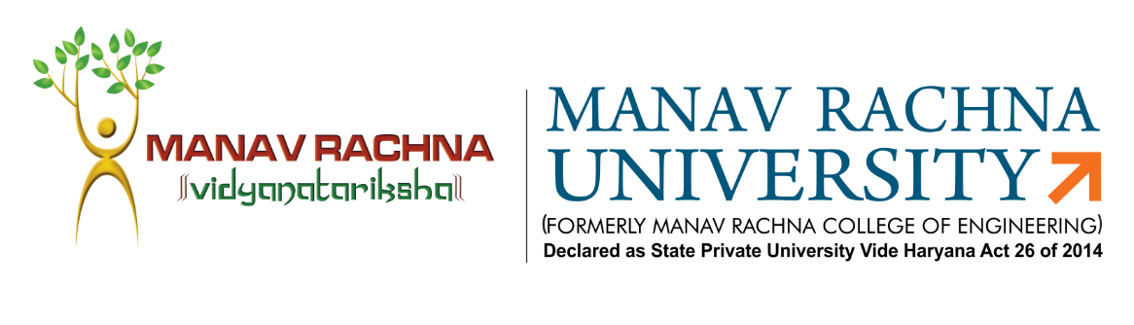

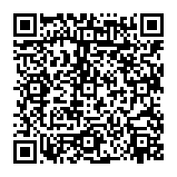
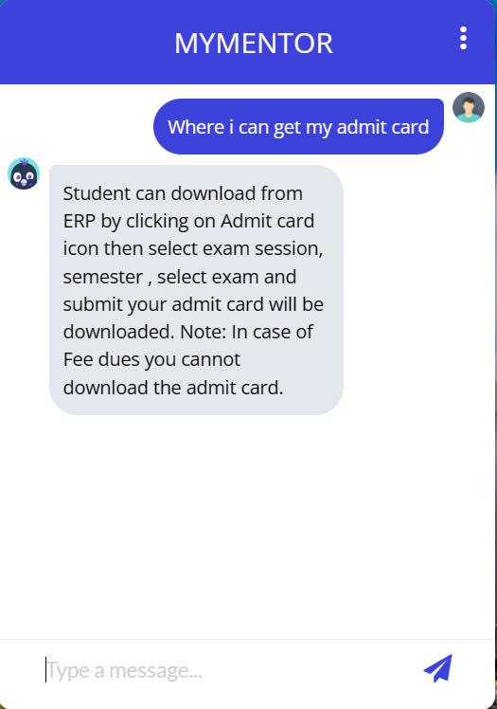
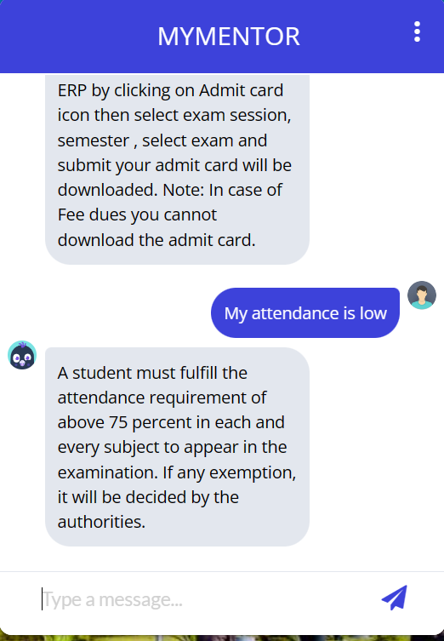
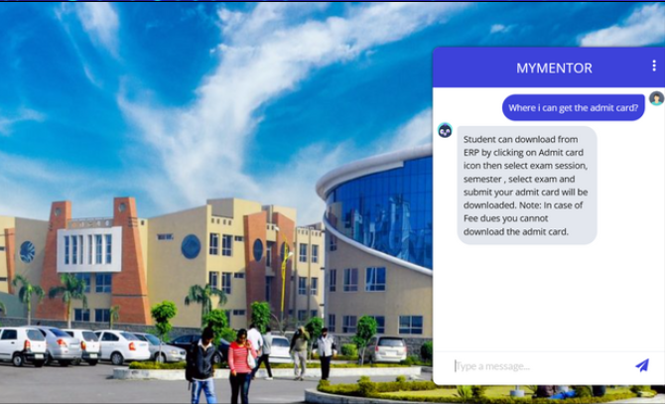
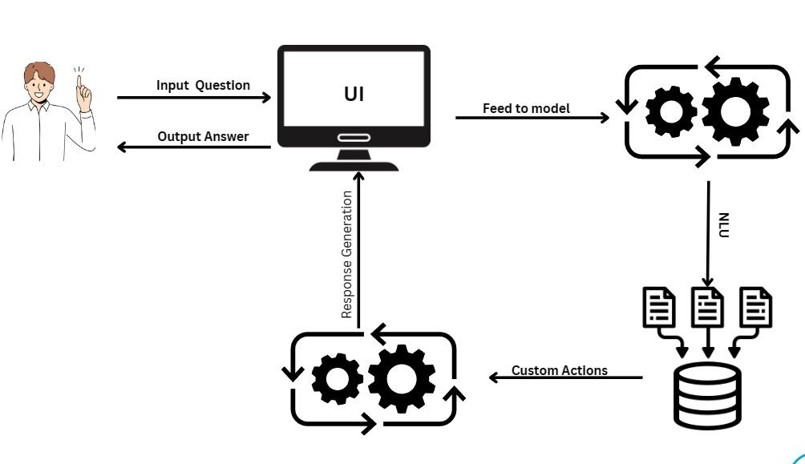
MYMENTOR
A CHATBOT
Your All-in-One Student Solution, answers all frequent student queries
Team: Varun Kumar Gera, B.Tech CSE
Mentor: Dr. Mamta Arora, Associate Professor, Dept. of CST
Manav Rachna University, Faridabad
Problem Statement
Methodology
Despite the increasing demand for timely and efficient support services in university, the current systems often struggle to address the frequent queries of students regarding course registration, fee issues, clubs, scholarships, examination queries, and other common concerns. This leads to a significant burden on faculty and staff, as well as potential delays in student access to essential information. The lack of a streamlined solution contributes to decreased student engagement and dissatisfaction. Therefore, there is a pressing need to develop an AI-powered chatbot [1] tailored to university settings, capable of delivering accurate and prompt responses to student inquiries, thereby alleviating the burden on faculty and staff while enhancing student satisfaction and engagement. Additionally, the absence of comprehensive research documenting the development process, performance, and impact of such chatbots in educational contexts underscores the importance of further investigation to inform future advancements in this area.
The development process for the university chatbot follows an Agile methodology, enabling iterative progress and continual incorporation of feedback. Initially, data extraction from university policy documents focuses on essential topics such as examinations, fees, academics, placements, and co-curricular activities, which are then organized into a structured format. Subsequently, utilizing Rasa Open Source, the project progresses through defining intents, entities, and responses, crafting conversation flows, and training the NLU and Core models. Concurrently, frontend UI design integrating frontend tools to create a user-friendly interface across devices. Integration and testing phases ensure seamless communication between the frontend and backend components, with thorough unit, integration, and user acceptance testing guiding iterative refinement. Continuous user feedback and testing insights drive enhancements to functionality, dialogue flows, and UI design, culminating in the creation of a robust and user-friendly chatbot tailored to university needs. This methodology serves as a structured framework to deliver a chatbot that enhances the student experience and facilitates access to vital university information.
Introduction
The project aims to develop a chatbot [2] that can address the frequent queries of university students related to course registration, fee issues, clubs, scholarships, examination queries, and other common student concerns. By providing a platform that can answer student’s queries in a timely and efficient manner, we hope to improve student engagement and save faculty time in addressing frequent student queries. The chatbot will leverage the latest AI technologies to ensure [3] that it is able to provide accurate and helpful responses to student’s queries.
Fig 3. Chatbot screenshots
Future Scope
Fig 2. Methodology Flowchart
The future scope of this project encompasses several exciting avenues for expansion and enhancement. Firstly, there are plans to extend the chatbot's capabilities to cater to specific departmental inquiries within the university, including but not limited to Law, Commerce, Humanities, and Arts. Additionally, efforts will be made to scale the chatbot across other institutes under the Manav Rachna Educational Institutions umbrella, thereby broadening its reach and utility. Furthermore, the integration of advanced features such as voice search, read-aloud functionality, and image input will enhance the chatbot's accessibility and usability, catering to diverse user preferences and needs. Moreover, the continual refinement and evolution of the underlying framework and technologies involved will ensure the chatbot remains at the forefront of AI-driven student support solutions, delivering even greater efficiency and effectiveness in addressing user queries and concerns.
Objectives
Discussion & Conclusions
The primary objective of this study is to develop a chatbot that can address the frequent queries of university students related to course registration, fee issues, clubs, scholarships, examination queries, and other common student concerns which help student to get right information on right time. We also aim to save faculty and staff time in addressing frequent student queries.
The secondary objective is a research paper that documents the findings of study and insights from the development process. The paper will provide a detailed analysis of the chatbot’s performance, user feedback, and potential impact on student. The research will contribute to the growing body of knowledge on the use of chatbots in education and help inform future developments in this field.
Our project introduces an advanced chatbot system to benefit university students and faculty. Students gain quick access to academic assistance. Faculty members can save their time as frequent student queries are answered by a chatbot quickly and accurately. By leveraging conversational model, we create a more accessible and engaging educational environment, fostering success and innovation of university. By incorporating this chatbot in university, students can gain access to support and services at their fingertips. By answering all the frequent student queries weather its related to examination, academics, fee, internship or placement the platform will save the loot of time of various departments within the university.
Student
Project Mentor
References
Name : Varun Kumar Gera
Manav Rachna University
Email: varunkumargera@gmail.com
Phone: 9971452537
Name: Dr. Mamta Arora
Manav Rachna University
Email: mamta@mru.edu.in
Phone: 9873599315
[1] N. N. Khin and K. M. Soe, “University Chatbot using Artificial Intelligence Markup Language,” in 2020 IEEE Conference on Computer Applications(ICCA), Feb. 2020, pp. 1–5. doi: 10.1109/ICCA49400.2020.9022814.
[2] “Developing a Chatbot for College Student Programme Advisement | Request PDF.” Accessed: Feb. 06, 2024. [Online]. Available: https://www.researchgate.net/publication/327490362_Developing_a_Chatbot_for_College_Student_Programme_Advisement
[3] A. Balderas, R. F. García-Mena, M. Huerta, N. Mora, and J. M. Dodero, “Chatbot for communicating with university students in emergency situation,” Heliyon, vol. 9, no. 9, p. e19517, Sep. 2023, doi: 10.1016/j.heliyon.2023.e19517.

